Slide 1
COMP4300 Computer Architecture
Fall 2019
Richard Chapman

Slide 2
What is a computer?
Ability to do math(“add 1”)
Ability to make decisions (if/then/else)
Ability to iterate
Ability to store data
Ability to execute stored program

Slide 3
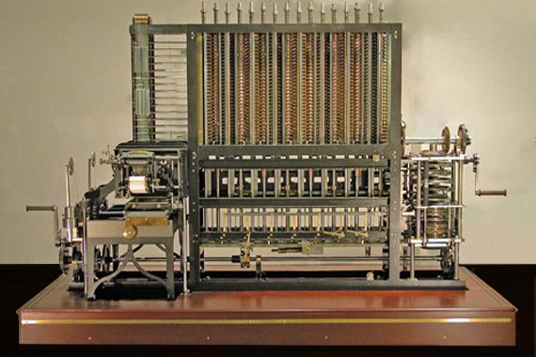
Origins of modern computing
Analytical engine, Charles Babbage, Ada Lovelace, entirely mechanical

Slide 4
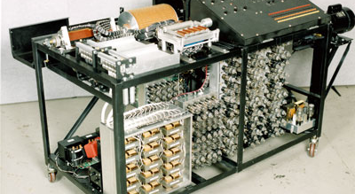
Atanasoff-Berry Computer (tubes, not programmable)

Slide 5
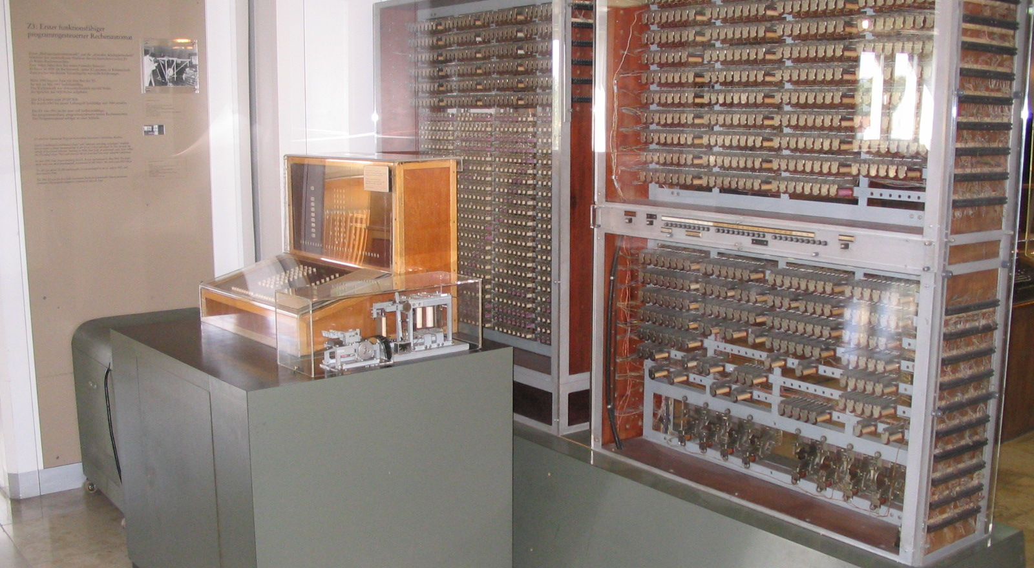
Konrad Zuse (relays, programmable)

Slide 6
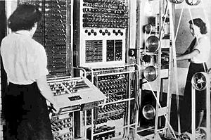
British Colossus
Alan Turing, Bletchley park, code breaking

Slide 7
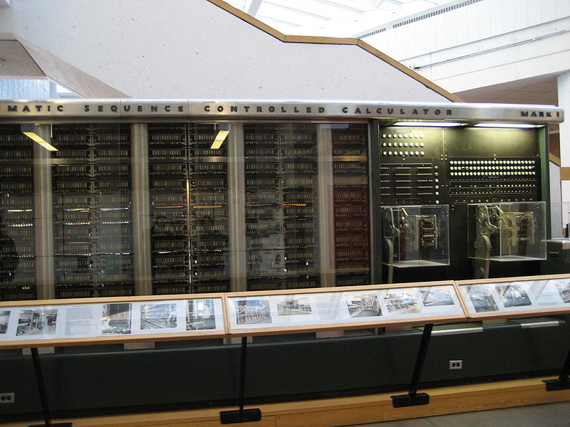
Harvard Mark I
Separate program,data memories

Slide 8
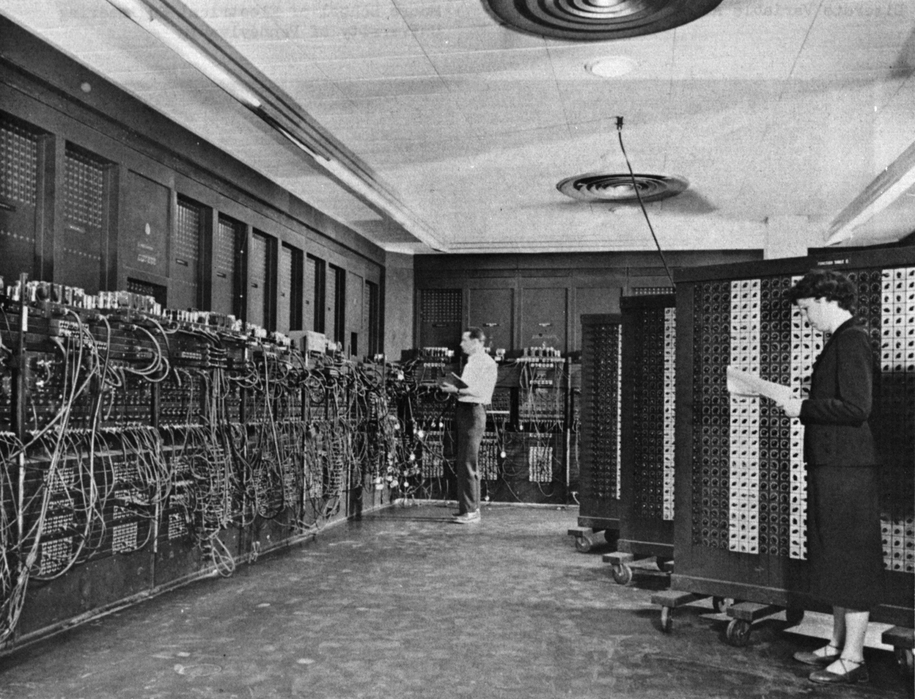
Eckert-Mauchley, U. Penn
EDSAC,ENIAC,EDVAC,UNIVAC: first electronic, fully programmable computer

Slide 9
1950’s-early 1960’s
After WWII, computers cost millions, were the size of buildings, used only by government and largest corporations
Transition from vacuum tubes to transistors
IBM makes its fortune: IBM model 1400. Expected to make a few hundred. Made over 10,000 (rented, not sold). Now any reasonable-size “enterprise” had a computer.

Slide 10
1964: Birth of Computer Architecture
Fred Brooks, IBM System/360
Big problem of computer manufacturers: backward/forward compatibility
Idea: present a model of the machine to (assembly language) programmers that DOES NOT change from model to model within the product line
IBM today still makes machines with S/360 compatibility (IBM Z system, Poughkeepsie, NY, z14 released July 2017)

Slide 11
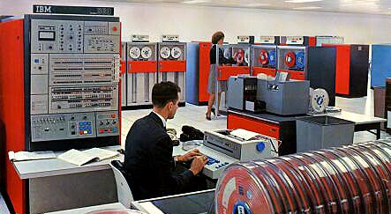
System/360

Slide 12
1960’s
I/O by punch card, teleprinter, removable-platter hard drive, 11-track magnetic tape, chain printer
The first clones: Amdahl computers could run S/360 software (idea of architecture made it possible)
IBM and the seven dwarves: Univac, Honeywell, Burroughs, Control Data corp, National Cash Register (NCR), RCA, General Electric

Slide 13
1960’s mainframe
Typical specs
32-bit CPU (16 registers)
0.034 MIPS to 1.5MIPS (MIPS as a term didn’t exist)
8KB to 8MB main memory (magnetic cores)
High-end machines as sophisticated as anything available today in terms of exploitation of instruction-level parallelism
Programmed primarily in assembler, some FORTRAN or COBOL.
Batch job submission, no interactive terminals

Slide 14
Late 1960’s
Transition from Discrete transistors to small-scale integrated circuits
Mini-computers (16-bit datapath, price more in range of $10,000-$100,000 rather than $100,000-$1M): Data General, Digital Equipment Corp, supported a single or a few interactive users with CRT’s

Slide 15
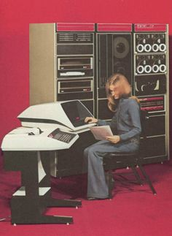
DEC pdp-11/20 ($100k)

Slide 16
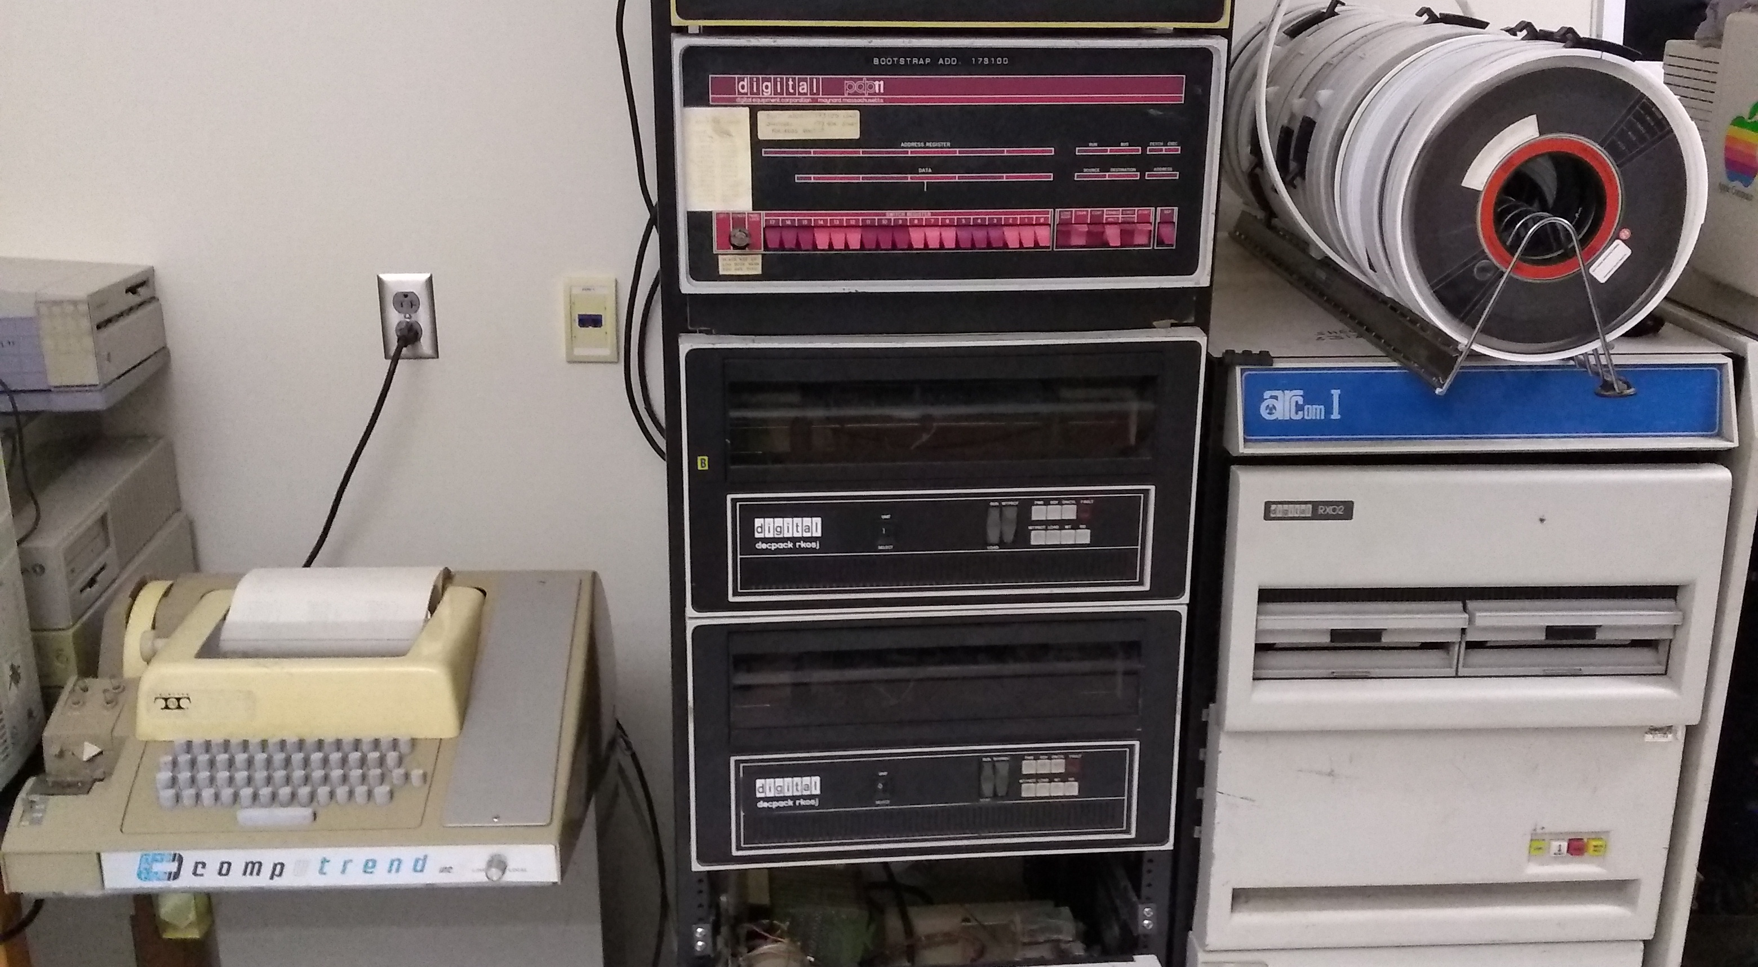
Auburn’s PDP-11/20

Slide 17
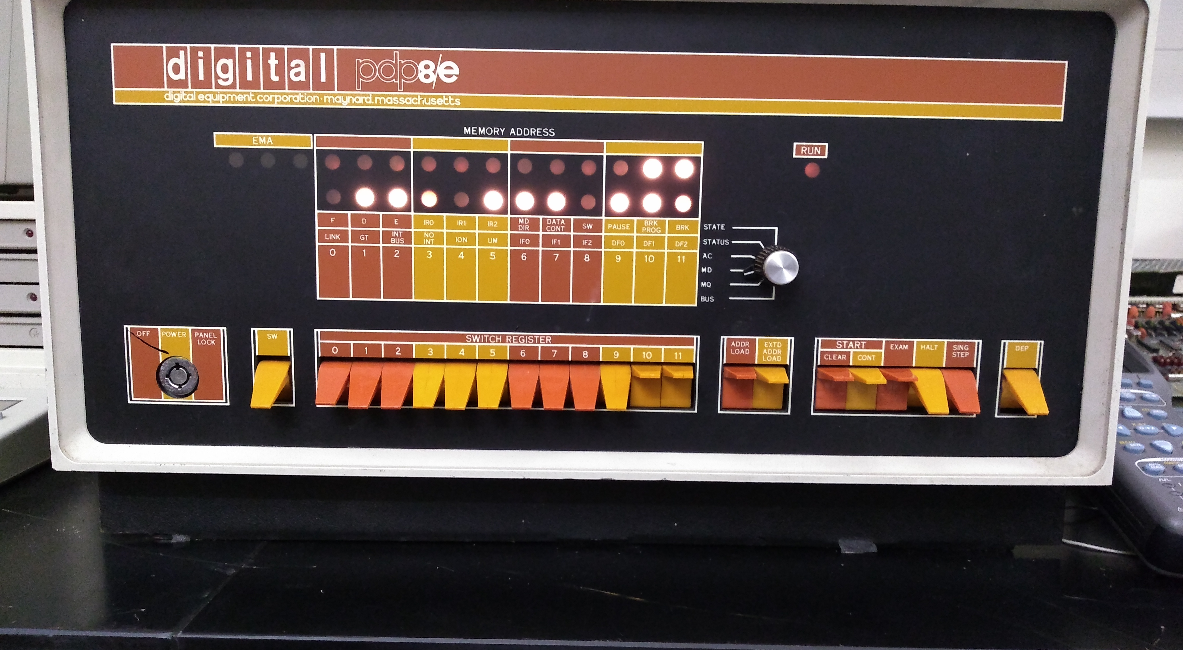
Auburn’s PDP-8/E

Slide 18
1970’s
IBM had a lock on mainframe market: US Anti-trust litigation
Department-sized units, small-businesses had minicomputers (size of a fridge or two)
Invention of the microprocessor: Intel 8008, first CPU on a single chip
Large-scale integration (LSI) – 20-50k transistors on a chip
Microcomputers: single user, 8-bit cpu, 4k-64kmem, $1000-$5000
Unix OS developed by ATT/Bell Labs runs on DEC minicomputers, ported to many, many others

Slide 19
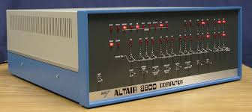
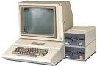
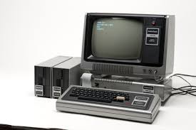
“Home” computers ($1k)

Slide 20
1980’s
Original IBM PC: 1981, killer app was the spreadsheet
8-bit and 16-bit microprocessors (reprise of mainframe history on single chips)
Minicomputers: DEC VAX 11/780 (1 MIPS, by definition)
Core memory replaced by DRAM
Intel 386: watershed, supported memory protection in hardware

Slide 21
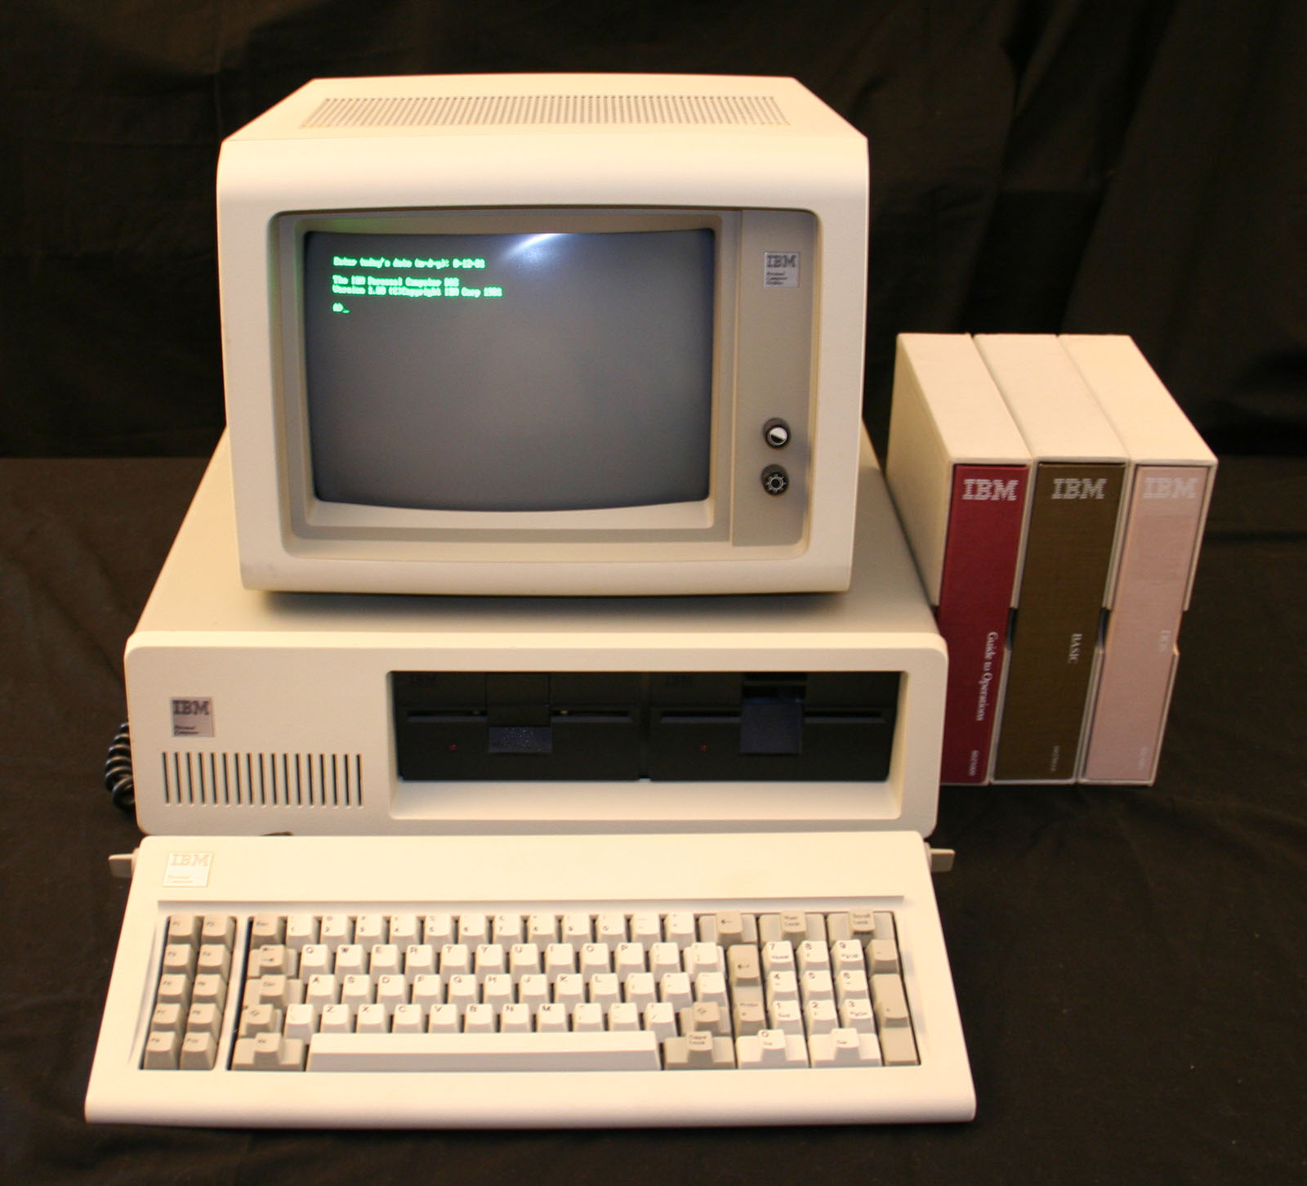
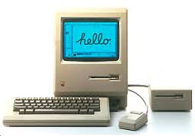
IBM original PC (model 5150), original Mac (each about $4k)

Slide 22
1990’s
Workstations with 32-bit processors (Sun microsystems, Data General, Apollo, HP) running versions of Unix
Development of Linux, open-source version of Unix that runs on Intel 386-or later cpu’s (and later many others)
PC running Windows (v 3.1, Win 95) becomes dominant in business
Rise of Internet
Intel 860: 1 million transistors on a chip
RISC, superscalar processors

Slide 23
2000-2010’s
Intel’s 32-bit architecture finally runs out of steam (and VLIW based IA-64 fails because of lack of backward compatibility with IA-32)
Rise of importance of mobile and embedded systems (mostly running ARM cpu’s, based on BBC Acorn, modified to be a RISC)
Power consumption and clock distribution limit speed of cpu’s
Ever-bigger caches

Slide 24
The VLSI manufacturing process
Photolithography
Masks
Wafers, Dies
Yield
Packaging
How real-estate is used

Slide 25
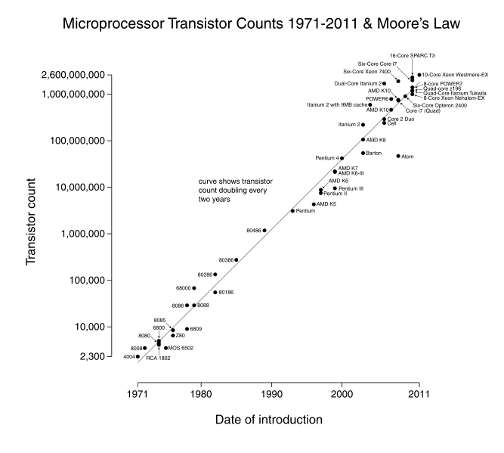
Moore’s Law

Slide 26
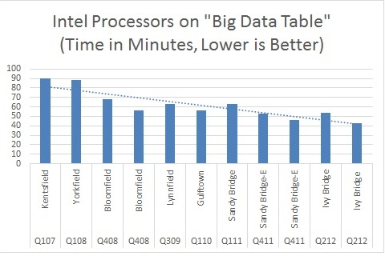
Early 2010’s: Moore Runs out of steam

Slide 27
State of the art
Feature size (smallest thing that can be rendered in silicon) 7nm
5nm is theoretical limit – quantum tunneling begins
Uniprocessor clock speed; 4-5Ghz (flawed measure of performance)
Power consumption, heat dissipation (desktop CPU, intel Core i7) 95-140W

Slide 28
Future directions
Portable, mobile devices: tablets, phones, telematics, IoT
Multi-core chips
Massively parallel clusters
GPU general-purpose computing

